Slide 1


Predicting Yeast Gene Functions with Machine Learning
This presentation outlines a machine learning approach to predict Gene Ontology terms for yeast gene sequences.
by P218024 Sher Ali

Slide 2
Project Objective
Goal
Purpose
Develop a machine learning model to predict Gene Ontology terms for yeast gene sequences.
Improve functional annotation of yeast genes by predicting multiple functions for each sequence.

Slide 3
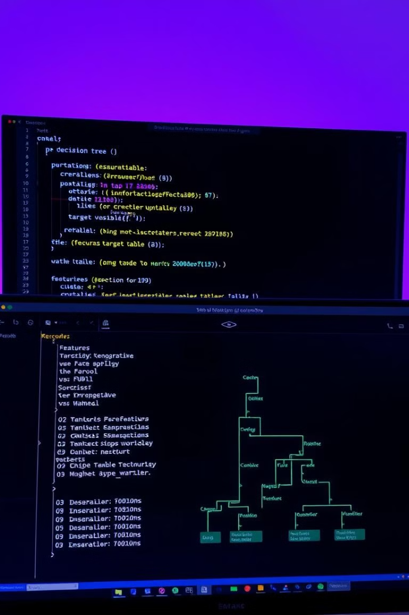
Problem Description
Multilabel Classification
Dataset
FASTA file with yeast sequences and a mapping file for GO terms.
Each yeast gene sequence can have multiple GO terms.

Slide 4
Data Exploration
Step 1
Step 2
Analyze the sequence lengths and types within the FASTA file.
Examine the distribution of GO terms across sequences to understand their frequency.

Slide 5
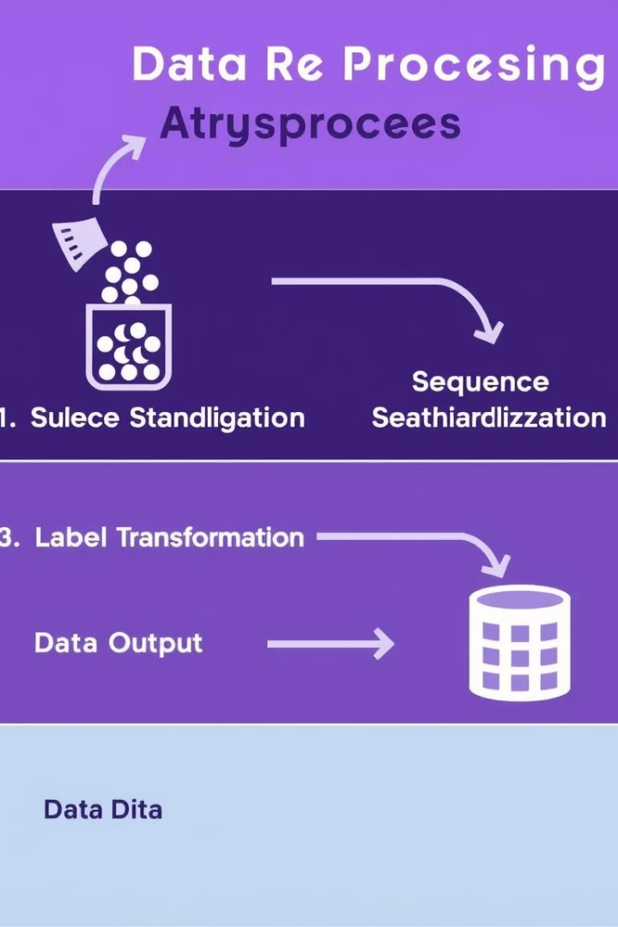
Data Preprocessing
Sequence Standardization
Label Transformation
Convert GO terms into binary labels for each sequence.
Format all sequences consistently for feature extraction.

Slide 6
Feature Extraction
Encoding Sequences
Optional Step
Use one-hot encoding for short sequences and k-mer frequency analysis for identifying repeating patterns.
Utilize Principal Component Analysis (PCA) if the number of features is excessive.

Slide 7
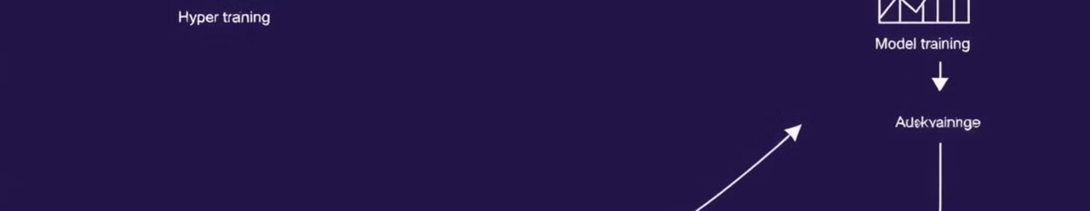




Model Selection & Training
Random Forest
Support Vector Machine (SVM)
Convolutional Neural Network (CNN)
Recurrent Neural Network (RNN)
A traditional ensemble method for classification.
A classic machine learning algorithm for separating data points.
Suitable for processing sequences with complex patterns.
Well-suited for handling sequential data.

Slide 8
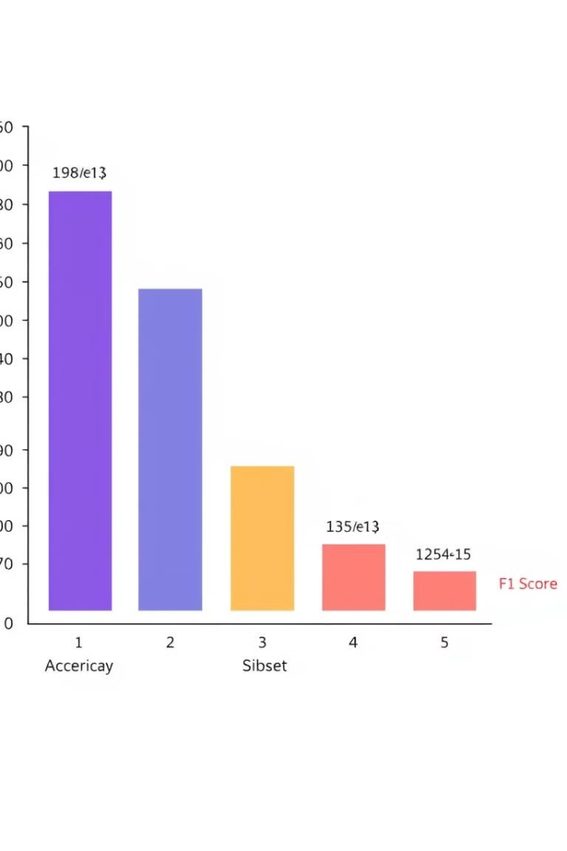
Model Evaluation
1
Hamming Loss
Percentage of incorrect labels predicted.
2
Subset Accuracy
Accuracy of predicting all GO terms correctly.
3
F1 Score
Measures the balance between precision and recall.

Slide 9
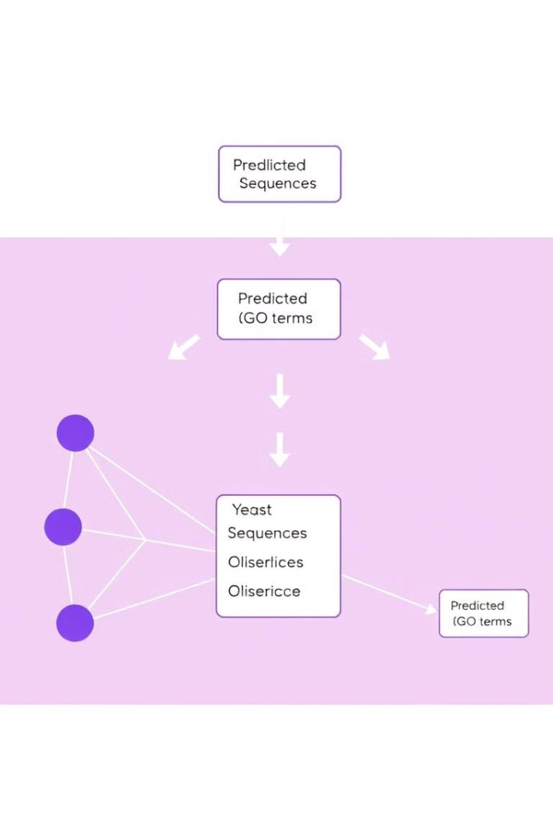


Expected Outcome
Result
A model capable of predicting multiple GO terms for each yeast sequence.
Impact
Automates functional annotation of yeast genes, enhancing research efficiency.

Slide 10

Next Steps
The next step involves deploying the trained model for practical applications in yeast gene research. Potential applications include:
Integrating the model into existing bioinformatics pipelines.
Exploring the model's performance on new yeast datasets.
Disseminating the model to the scientific community.

